Slide 1
Power BI Embedded
FSI CSU Swarm

Slide 2

Power BI Functionalities
 | Embedding Power BI Content | The Power BI service (SaaS) and the Power BI Embedded service in Azure (PaaS) have APIs for embedding your dashboards and reports. This feature means you can access the latest Power BI features – such as dashboards, gateways, and app workspaces – when embedding your content.
 | Developing Custom visuals | You can use custom visuals with Power BI to create a unique type of visual that’s tailored to you or your company. Often these custom visuals are created by developers. They're built when the multitude of visuals that are included with Power BI don’t quite meet your needs.
 | Using API Automation | Power BI displays dashboards that are interactive, and can be created and updated from many different data sources in real time. Using any programming language that supports REST calls, you can create apps that integrate with a Power BI dashboard in real time. You can also integrate Power BI tiles and reports into apps.

Slide 3
Power BI Service
Provides cloud-based foundation for power BI platform
Accessible with browser through https://app.Powerbi.Com
Accessible through power BI mobile apps
Accessible to developers through power BI service API

Slide 4

Using the Power BI Service API
Accessible by making direct REST calls against service
Accessible by using assembly DLL that abstracts away REST calls
Assembly DLL is named microsoft.Powerbi.Api.Dll
Assembly DLL part of nuget package (microsoft.Powerbi.Api)
Calling service requires authentication with azure active directory

Slide 5
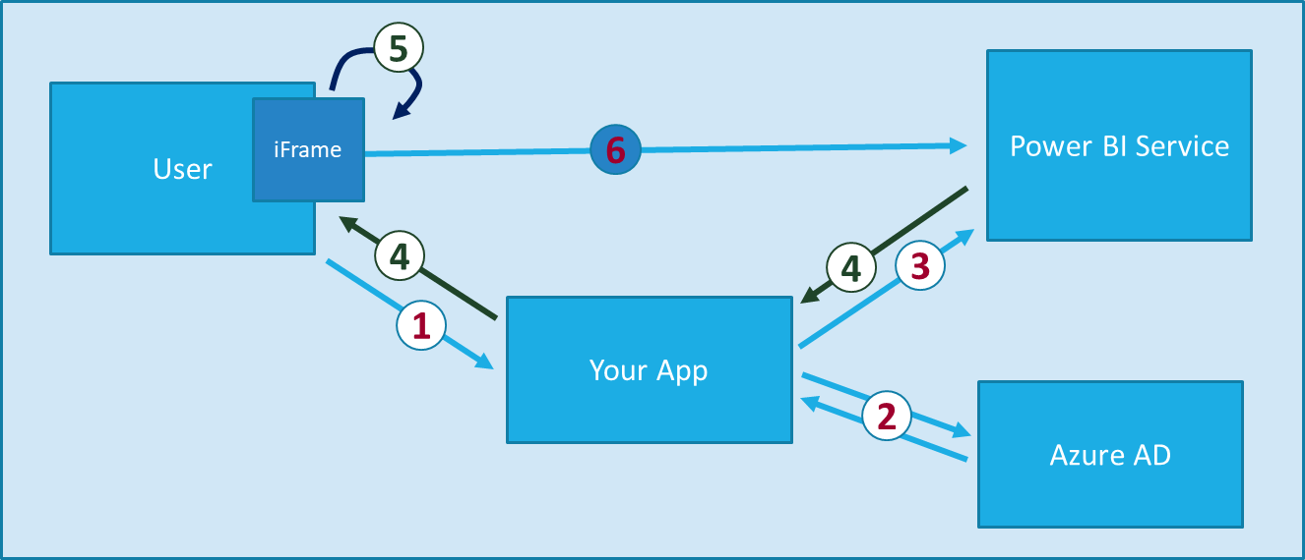
Power BI Embedding – The Big Picture
User launches your app using a browser
App authenticates with azure active directory and obtains access token
App uses access token to call to power BI service API
App retrieves data for embedded resource and passes it to browser.
Client-side code uses power bi javascript api to create embedded resource
Embedded resource session created between browser and power BI service
Notes:
https://docs.microsoft.com/en-us/power-bi/developer/embedding

Slide 6
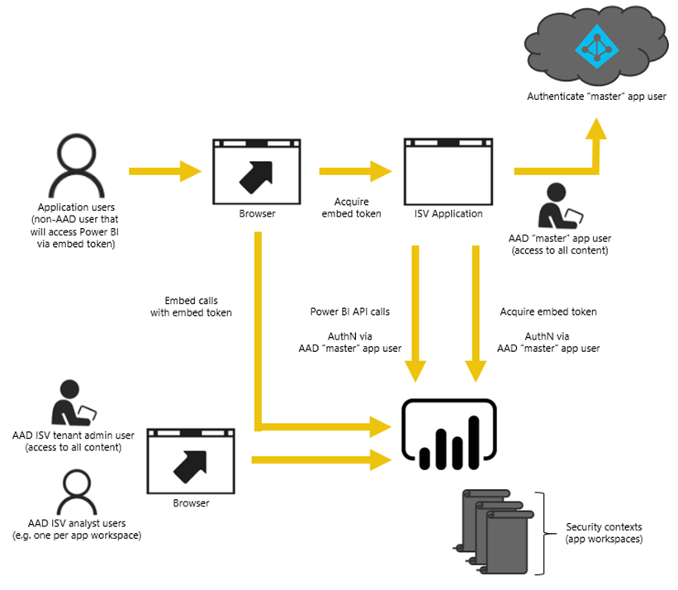
Power BI Embedding – The Big Picture
User launches your app using a browser
App authenticates with azure active directory and obtains access token
App uses access token to call to power BI service API
App retrieves data for embedded resource and passes it to browser.
Client-side code uses power bi javascript api to create embedded resource
Embedded resource session created between browser and power BI service

Slide 7
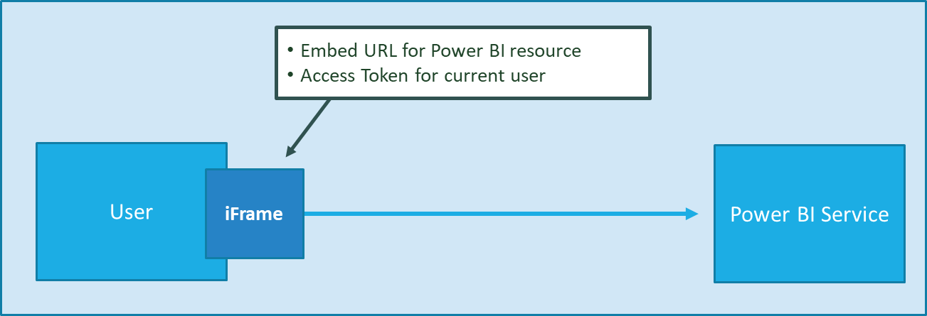
First Party Embedding
App authenticates current user with Azure AD
Your code accesses Power BI Service as current user
Embedding requires Azure AD access token for user
User requires Azure AD account and Power BI license
Your code has access to whatever user has access to

Slide 8
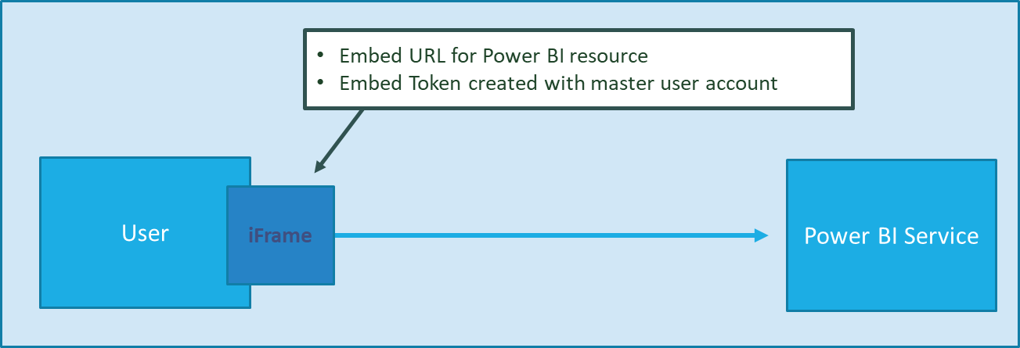
Third Party Embedding
App authenticates using Master User Account
Your code accesses Power BI Service as master user
Embedding uses embed token instead of access token
Users don’t need AAD accounts and Power BI licenses
Your code has access to whatever master has access to

Slide 9
First Party vs Third Party Embedding
What scenarios use first party embedding?
What scenarios use third party embedding?
Organizations where users have Power BI licenses
Embedding Power BI reports in SharePoint and Teams
Development should go beyond out-of-box experience
Scenarios where users don’t have Power BI licenses
Applications which have custom identity providers
Applications which use identity provider other than AAD

Slide 10
First Party vs Third Party Embedding Cont…
 | 1st Part Embedding | 3rd Party Embedding
Authentication flow | Authentication Code Grant Flow or Implicit Flow | Direct User Credentials
Identity used to call Power BI | Current User | Master User Account
Access to personal workspace | Yes | No
Access to app workspaces | Yes | Yes
Ability to reach non-licensed users | No | Yes
Supported Power BI Capacity SKUs | P* and EM* SKUs | P*, EM* and A* SKUs

Slide 11

Dedicated Capacities
Power BI workspaces run in two possible environments
Shared capacities
Dedicated capacities
Dedicated capacity required for third party embedding
Customer pays capacity-based fee for processors cores and RAM
No need to pay Microsoft for user licenses
Dedicated capacities come in two flavors
Power BI Premium capacities purchased through Office 365 SKU
Power BI Embedded capacities purchased through Azure SKU

Slide 12
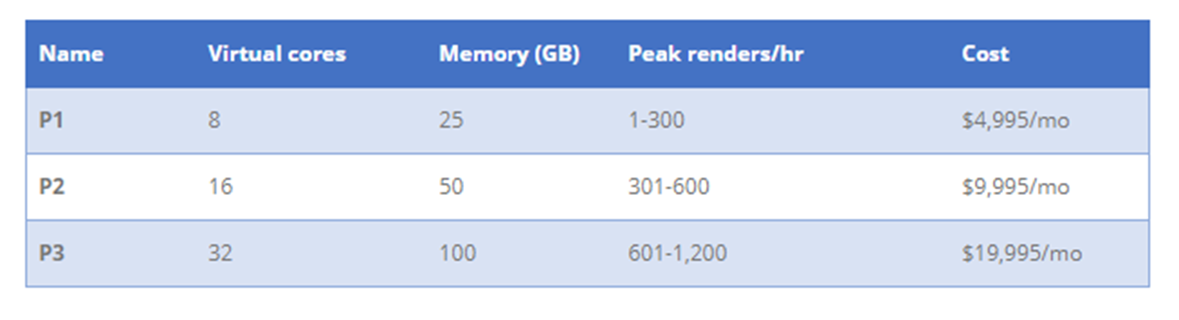
P SKUs (P is for Premium)
All-in version which allows greatest flexibility
Used to provide free users with access to apps and content
Used to support 1st party and 3rd party embedding
The more you pay per month, the more resources you get

Slide 13
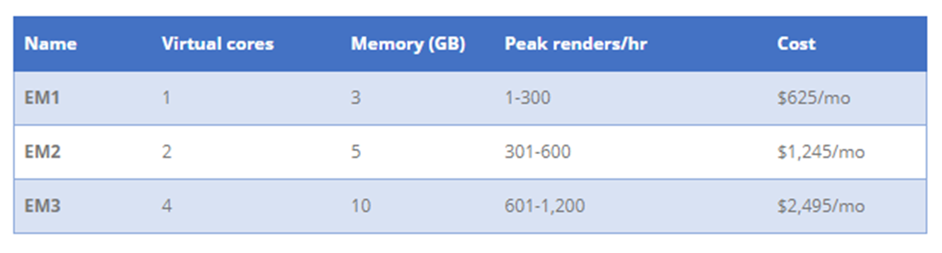
EM SKUs (EM is for Embedded)
SKUs for embedding into SaaS Applications
SaaS applications include SharePoint and Teams
Supports 1st party and 3rd party embedding
Does not provide user with access to PowerBI.com

Slide 14
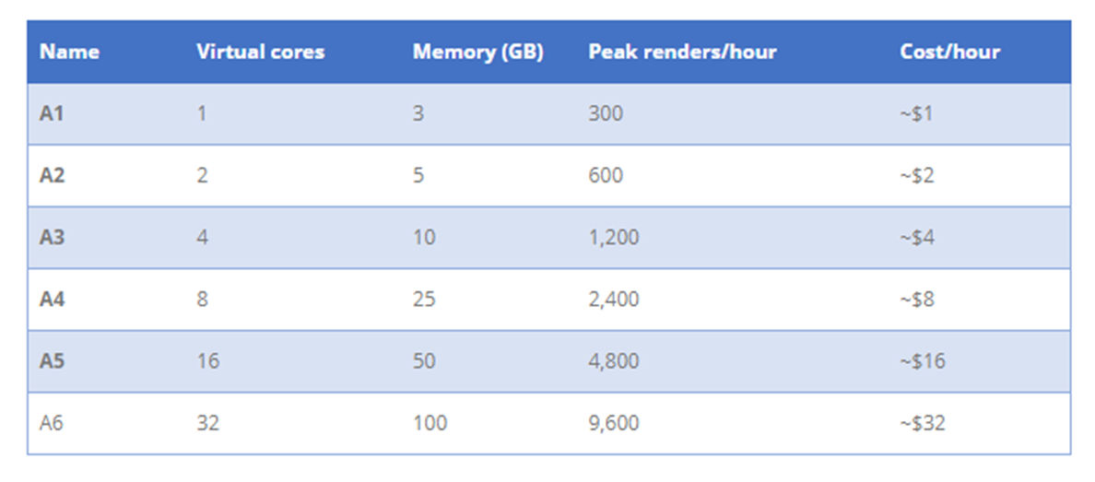
A SKUs (A is for Azure)
A SKU is a Platform-as-a-Service
Used by ISVs as the data visualization layer
Allows for PBI Embedding into Custom Applications
Only supports 3rd party embedding (i.e. App-Owns-Data model)

Slide 15
SKU Comparison
 | P SKU | EM SKU | A SKU
Purchased through… | Office 365 | Office 365 | Azure
Embed content in custom application | Yes | Yes | Yes
Share content with free PBI users outside PowerBI.com | Yes | Yes | No
Share content with free PBI users inside PowerBI.com | Yes | No | No
Billing | Monthly | Monthly | Hourly
Commitment | Monthly/Yearly | Yearly | None
Turn it off when your not using it | No | No | Yes

Slide 16


Workshop

Slide 17
Workshop Overview
Power BI Desktop
Import Data
Shape and combine data sources
Dynamic Row Level Security

Slide 18
Workshop
Will be using “Third-Party” Embedding for the application
Will be using _ SKU option
One Master account for each company.
User authentication via application.

Slide 19
Workshop Continued
Getting Data
Modeling
Visualizations
Exploring Data
Excel Integration
Publishing and Sharing

Slide 20
Resources
Resources
Power BI Community
Visit our documentation center
Estimate capacity guidance paper
Region availability
Ask us questions
Training
Get help building models

